Slide 1

Welcome to:
Maker Training Session
5:30 PM Tuesday, January 30, 2017
Broun Hall, Room 123

Slide 2


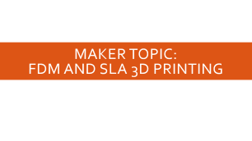

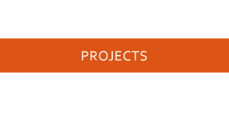
Agenda

Slide 3
About SPARC

Slide 4
Outreach

Slide 5
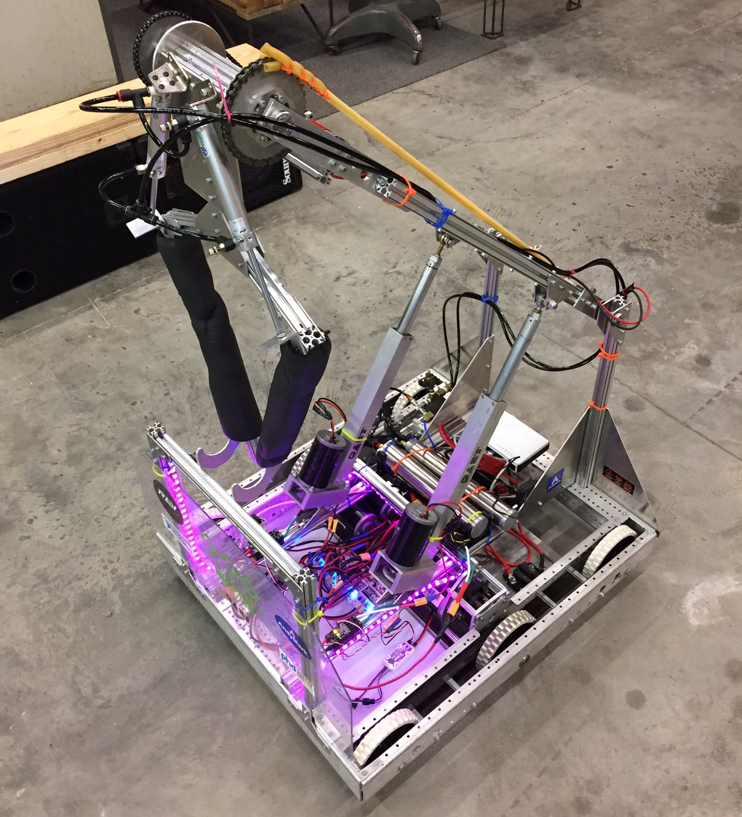
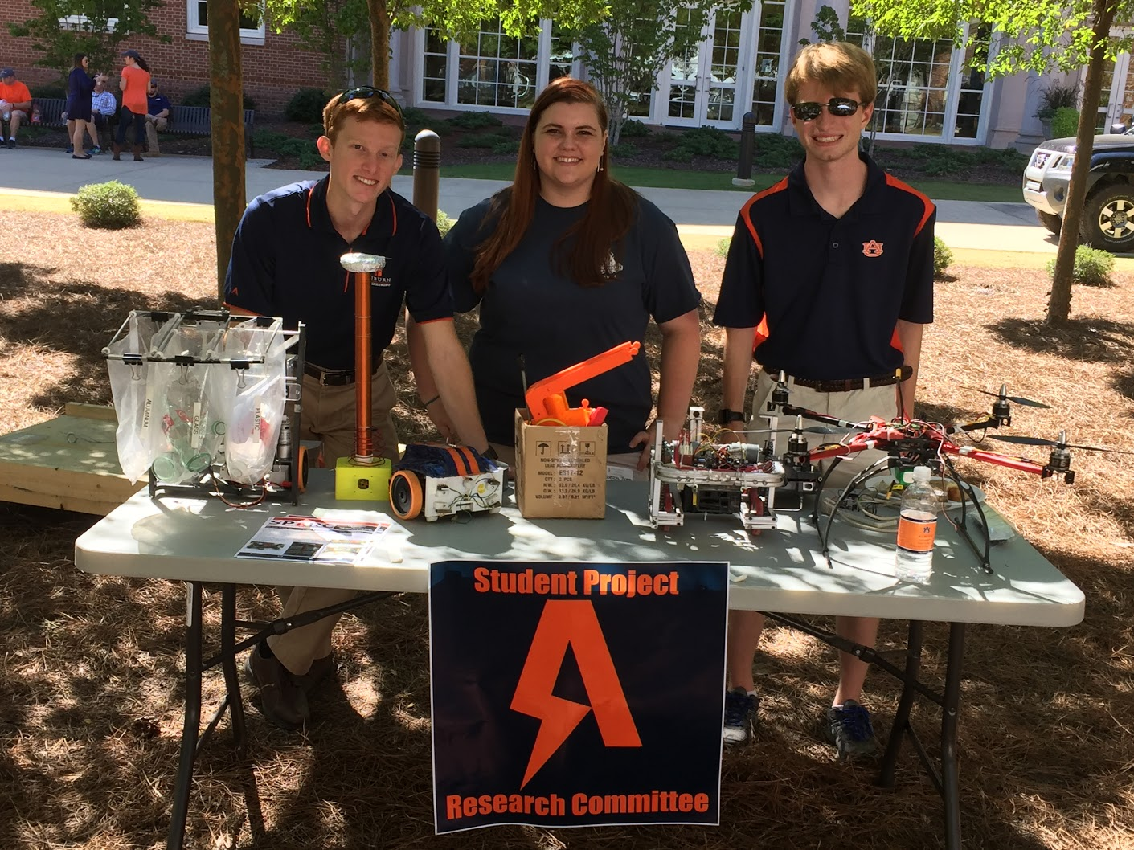
Outreach Events
Opelika HS FRC Team
Help mentor a FIRST Robotics Competition (FRC) Team
Mon Tue Thu: 3:30-6:30, Fri: 3:30-9:30, Sat:10-6
E-Day
Help display projects in Broun, Student Center, and Concourse to high school students.
Friday, February 23rd
Robot in 3 Days 2018 Bot
Engineering Tailgate 2016 SPARC Table
Notes:
Fall 2016
Loachapoka Robotics Mentoring- Mondays, Tuesdays, and Thursdays 3:00PM to 4:30PM
ECE Minority Presentation- November 14th
AJHS E-Day- November 17th
South’s Best- December 3-4th
SCORE Claw Machine- December 3-4th
Spring 2016
E-Day- Late February or early March
SPACE Day- Possible Event Next Semester
IEEE Sumo Robotics Competition (with local middle and high schools)- Spring 2017

Slide 6
Projects

Slide 7
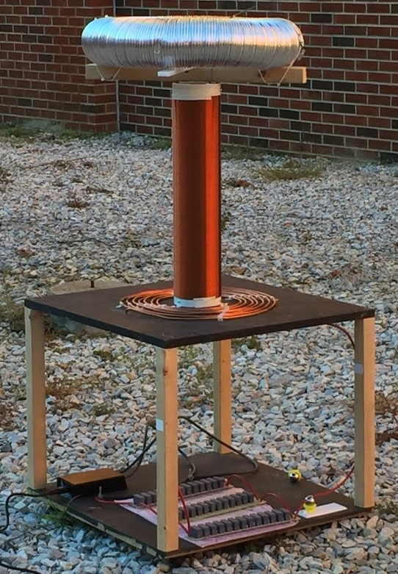
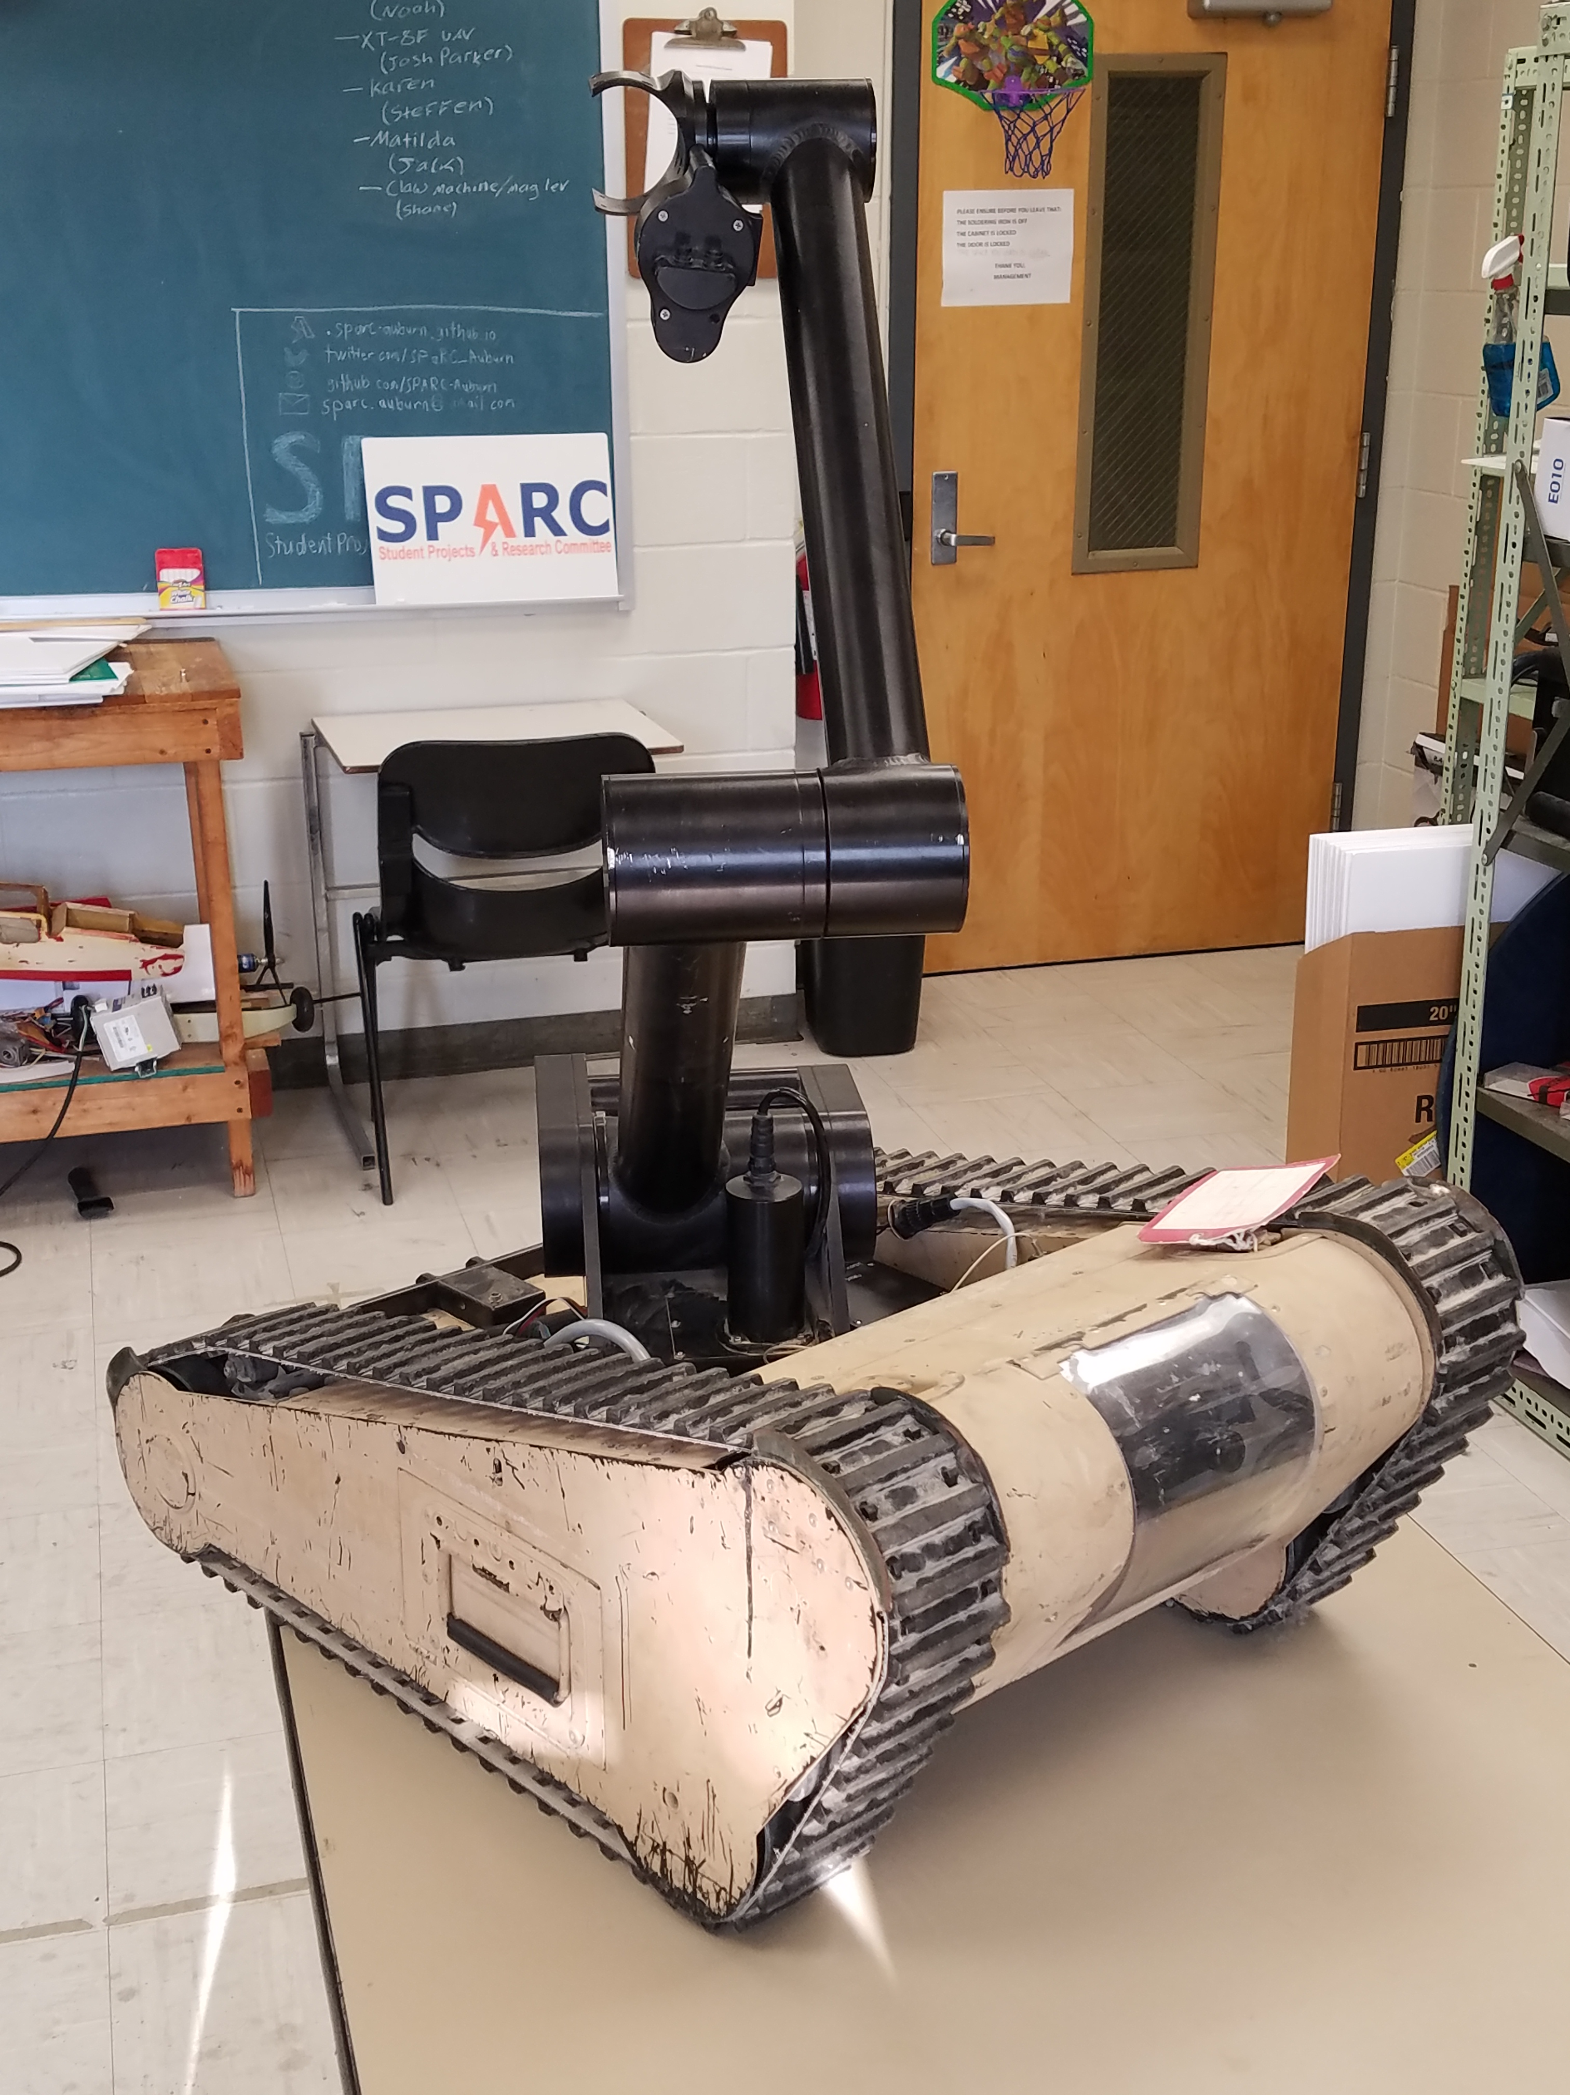
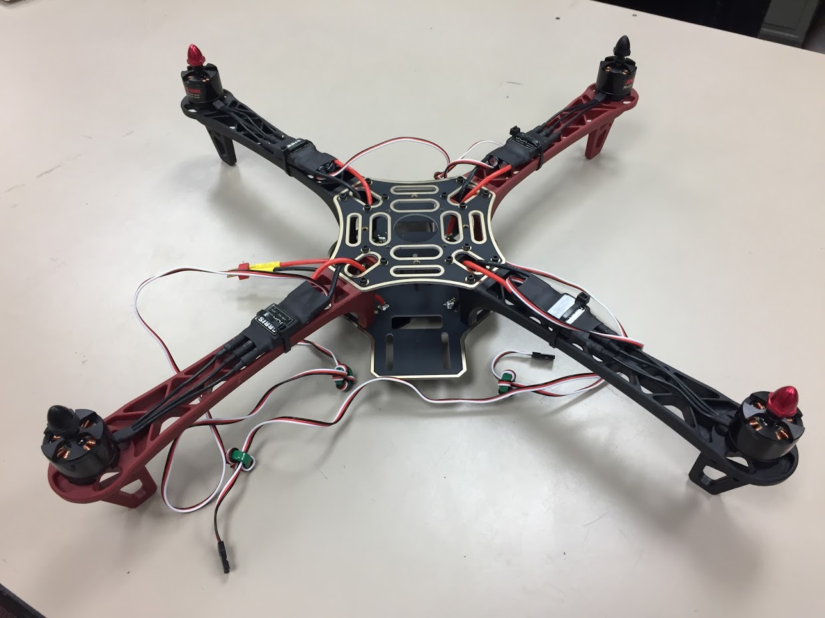
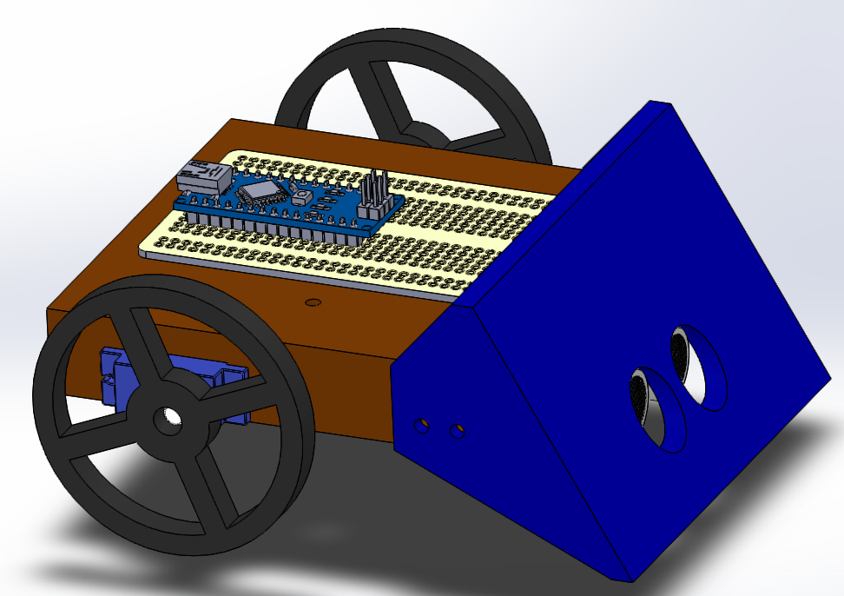
Spring 2018 Main Projects
MATILDA Robotics Platform
Tesla Coil
Unmanned Aerial Systems
Sumo Bot Competition

Slide 8
Maker Training Sessions

Slide 9
Maker Training Session Topics
Version Control (Git and GitHub)
3D CAD Parts (Solidworks)
3D Printing (Lulzbot Taz 3 w/ Cura Lulzbot Edition)
3D CAD Review and Assemblies (Solidworks)
Electrical Prototyping and intro to Arduino
Soldering and Electrical Fabrication
Basic Robotics Programming and PWM
Basic Sensor Programming

Slide 10
Maker Topic: FDM and SLA 3D Printing

Slide 11
Types of 3D Printers
Filament Based
Fused Deposition Modeling (FDM)- like a glue gun
Resin Based
Stereolithography (SLA)- UV laser cured liquid resin
Digital Light Processing (DLP)- light projector cured liquid resin
Powder Based
Selective Laser Sintering (SLS)- laser sintered powder
Selective Laser Melting (SLM)- laser melted powder
Electron Beam Melting (EBM)- electron beam melted powder
Binder Jetting (BJ)- drop-on-powder and binding agent
https://all3dp.com/1/types-of-3d-printers-3d-printing-technology/

Slide 12
FDM vs. SLA 3D Printing
Category | FDM (Lulzbot Taz, etc.) | SLA (Form 2, etc.)
Printer Speed | Faster than average | Slower than average
Minimum Layer Thickness | 50 microns | 25 microns
Typical Printer Price | $200-$3000 | $2000-$20,000+
Material Cost (Per Kg) | $20-$40 | $150-$200
Print Strength | Average | Slightly Below Average

Slide 13
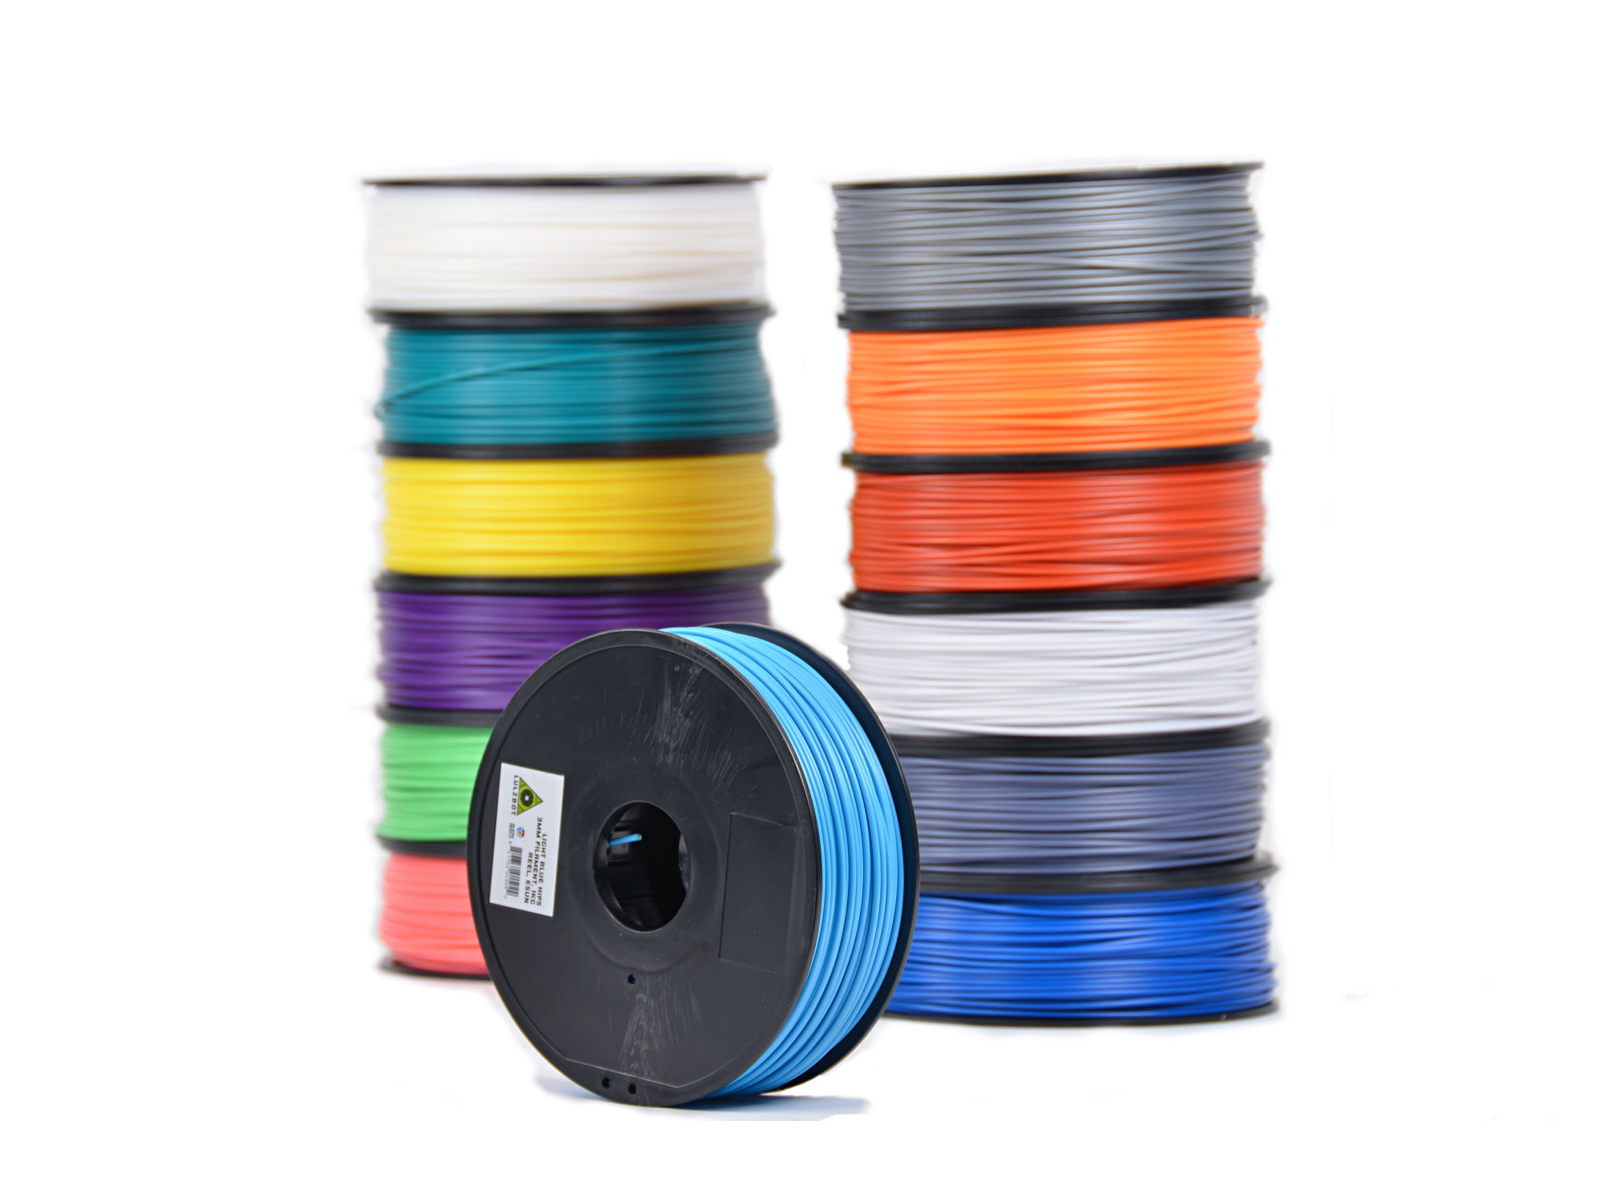
How does FDM 3D Printing Work?
Use a process to form objects in successive layers vertically.
Use a “hot end” that works similar to a glue gun by melting a plastic filament to print each layer.
Many have heated beds to allow better heat distribution preventing the warping of printed objects.
Many use a honeycomb like internal structure to save material and time.
Examples of Most popular 3D printing filaments:
ABS
PLA/PLA+
HIPS
Nylon

Slide 14
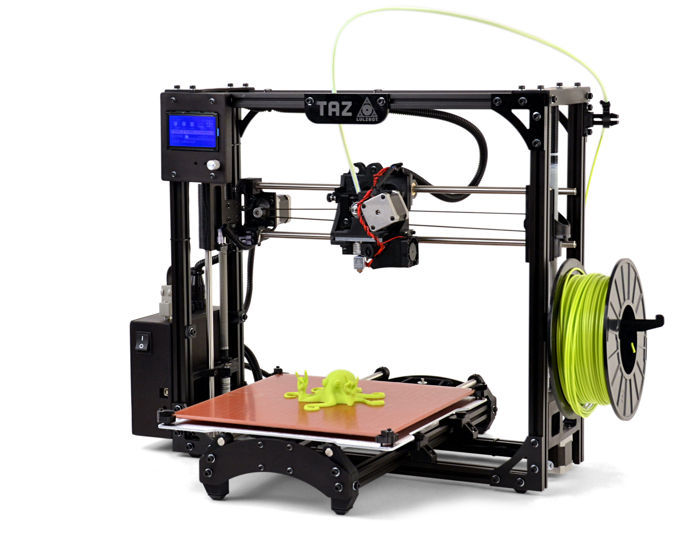
Lulzbot Taz
Control Interface
Filament
Tool Head
Hot End
Control Box / Power Supply
Heated Bed

Slide 15

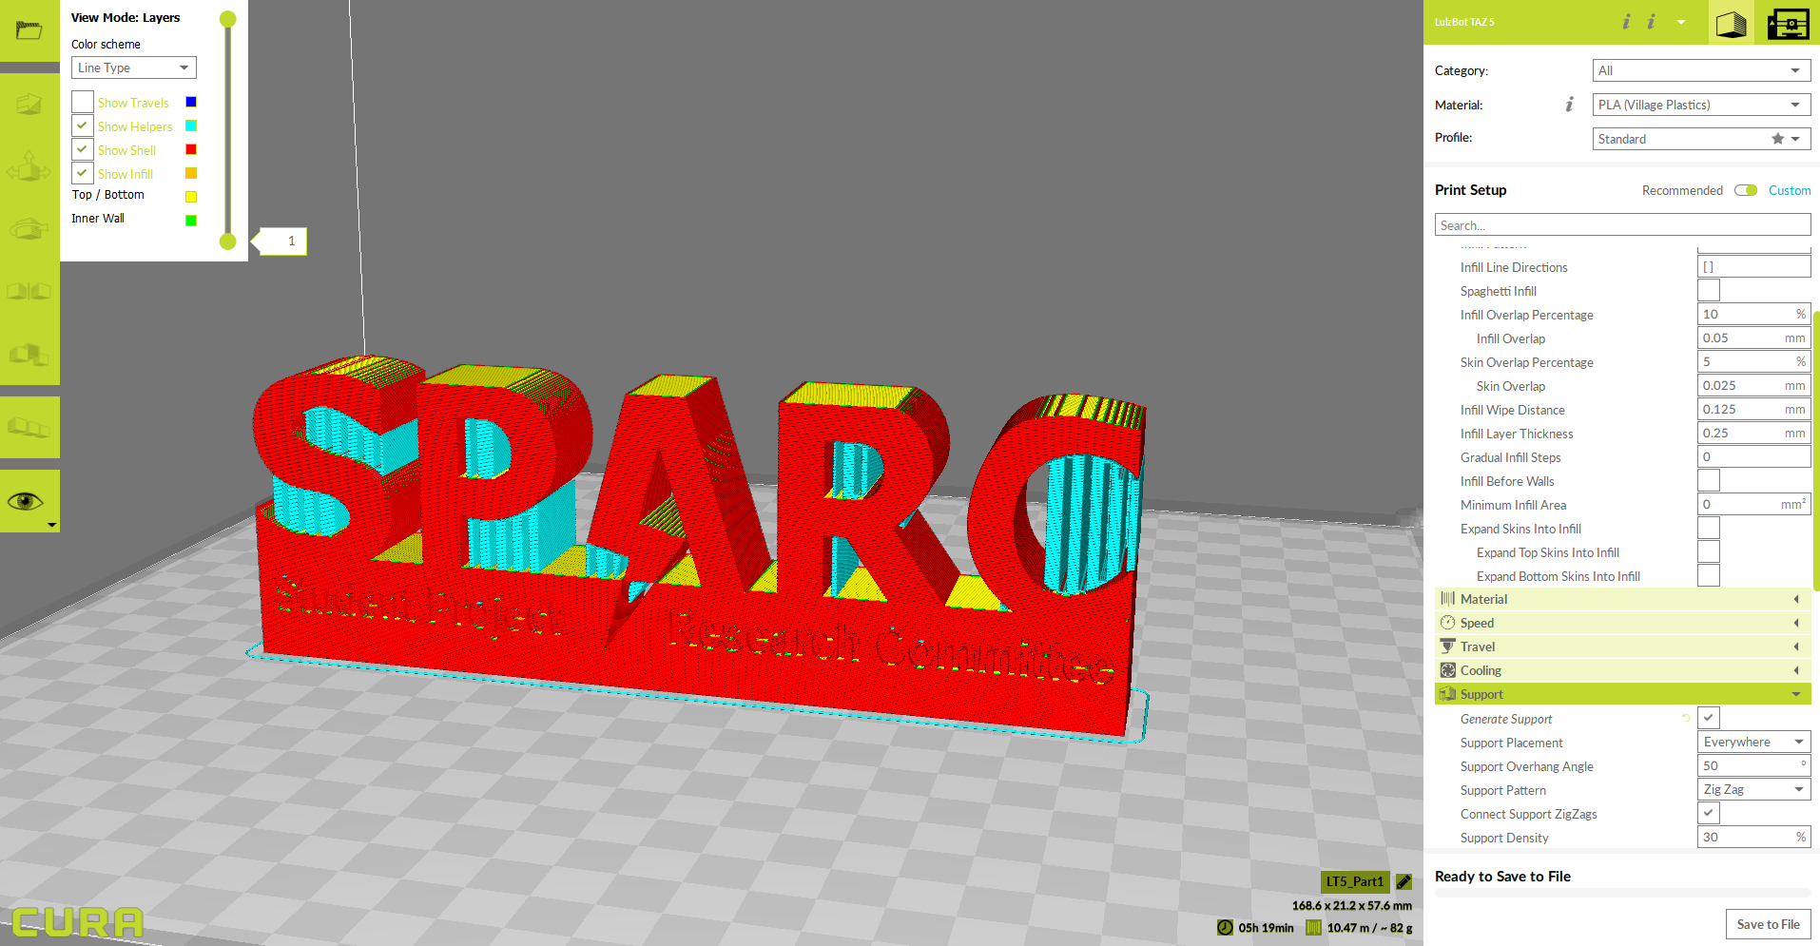
Using Cura Lulzbot Edition
Design 3D model using CAD like SolidWorks, SketchUp, Autodesk, etc.
Save model as .STL file
Open in Cura Lulzbot Edition
Set printer settings such as temperatures and fill density
Generates Gcode File that printer can interpret
Press print or save to SD card

Slide 16
How dOes SLA 3D Printing Work

Slide 17
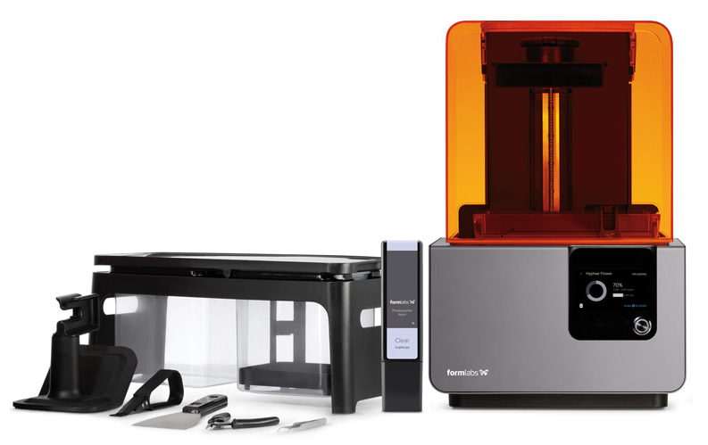
Formlabs Form 2
Build Platform
UV Shield
Isopropyl Alcohol Wash Station
Resin Cartridge
Resin Tank
Control Screen
Post Processing Tools

Slide 18
Using Form Labs Pre Form

